Slide 1
A Project Review On Air Canvas Using Computer Vision and Mediapipe
Team Details
T.ABHINAV (20EG105149)
T.MOUNIKA (20EG105152)
V. CHARAN TEJA(20EG105154)
K.ADITYA (20EG105158)
Project Supervisor
Mr. D. RAMANA KUMAR
Assistant Professor

Slide 2
Abstract
Air Canvas employs advanced motion-tracking technology to capture and interpret hand movements, allowing users to create digital art through intuitive and natural gestures in the air. Conventional tools often limit the spontaneity and creativity of artists, prompting the need for a more dynamic and inclusive platform. This project is rooted in the refinement of hand tracking systems, leveraging Open Computer Vision (OpenCV) and MediaPipe technologies . The core objective revolves around transforming hand movements into an intuitive drawing tool, which allows users to easily customize tools, select colors, and manipulate virtual brushes with natural movements(waving their hand). Air Canvas is more than just a digital art tool—it's like a door to a place where your imagination can go anywhere.

Slide 3
Introduction
In the realm of digital art creation, conventional tools often impose limitations on the freedom and creativity of artists. The Proposed project emerges as a pioneering solution, introducing an innovative computer vision-based drawing application that breaks the barriers of traditional input devices. By harnessing the power of real-time hand tracking and gesture recognition, this project offers users the ability to draw in the air, liberating them from the confines of physical tools.
Addressing challenges in precision and inclusivity, the Air Canvas project utilizes the Mediapipe library to detect hand landmarks, enabling users to craft their art through natural and intuitive hand gestures. The absence of depth sensors is overcome by leveraging a single camera, providing a platform for dynamic and expressive drawing experiences.
Beyond the realm of artistic expression, this project extends its impact by serving as a communication tool for individuals with hearing impairments. Through the integration of innovative technologies, the Air Canvas project strives to bridge communication gaps and empower users to express themselves seamlessly.

Slide 4
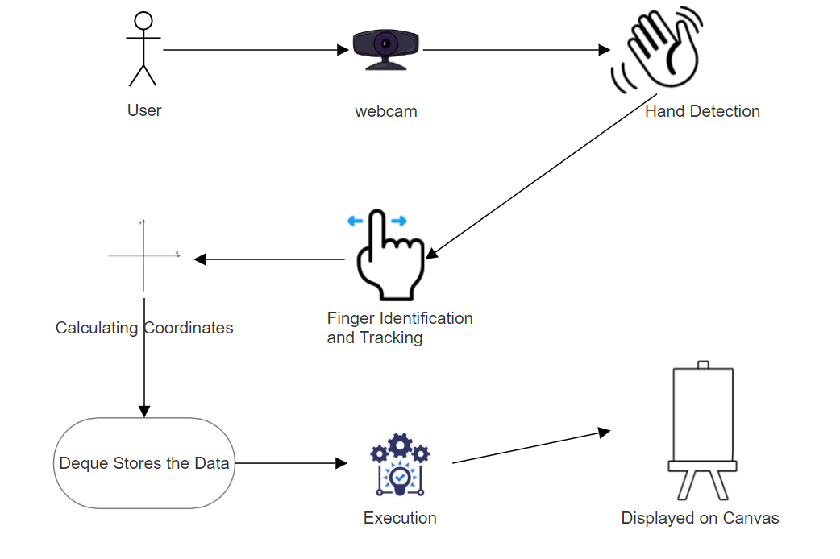
Concept Diagram

Slide 5
Literature
Author(s) | Method/Strategy | Advantages | Disadvantages
[1] B Anand ,T. Vinod, ,M Srinivas Rao, Interaction through Computer Vision Air Canvas. | Color Detection and tracking Convert captured frames to HSV color space Enable drawing on the screen by waving Detect coordinates Convert drawn images into commands and perform related tasks in real time. | Simplified user Interface. Increased interaction and engagement Real-time Drawing and Writing | Background Limitations Limited drawing tools Sensitivity to Lighting Conditions.
[2] Soham Pardeshi, Apar, Chaitanya, Atharv, Air Doodle :“ A Realtime Virtual Drawing Tool” | Video Capture Color Detection and Tracking Tracking and Path Generation Mask Creation and Drawing Canvas Display and Interaction | Natural and intuitive interaction Real-time visualization Cost-effective | Limited drawing tools Limited portability

Slide 6
Literature
Author(s) | Method | Advantages | Disadvantages
[3] Melvin Cabatuan , Isaiah Tupal. Vision-Based Hand Tracking System Development for Non-Face-to-Face Interaction. | 1.Color Thresholding 2.Hand Gesture Recognition | Accurate Hand Tracking 2. Real-time Drawing and Writing | Background Limitations Computation Requirements 3. Sensitivity to Lighting Conditions
[4] Shaurya Gulati, Ashish, Raghav Pradhan, Chetan, Mayank Virmani, Paint/Writing Application through WebCam using MediaPipe and OpenCV | Utilization of MediaPipe for hand detection. Implementation of color tracking for drawing or writing. Integration of live video from the webcam as the background for the canvas. | 1. Communication for the Deaf. 2. Ease of Use. 3. Real-time Visual Reference | Complexity of Implementation. Potential Limitations for Fine Details.

Slide 7
Literature
Author(s) | Method | Advantages | Disadvantages
[5] Vladimir Pavlovic, Rajeev, S.Huang, Visual Interpretation oHand Gestures for Human-Computer Interaction: A Review | Gesture Modeling Gesture Analysis and Recognition | 1. Can be used in various applications, such as sign language recognition and HCI environments. | 1. Current Systems are in their early stages, requiring further theoretical, and computational advances before gestures can be widely used for human-computer interaction.
[6] Gangadhara Rao Kommu, An Efficient Tool For Online Teaching Using OpenCV | Use OpenCV for tracking colored object movement. Preprocess the mask with morphological operations. Detect contours and find center coordinates. Store center coordinates in an array for successive frames. Draw points from the array on frames and canvas. | Enables dustless classrooms without the need for expensive touch screens. Allows for hands-free drawing and writing on any surface. | May have limitations in complex drawing and writing tasks 2. Relies on the accuracy of color tracking and object detection

Slide 8
Problem Statement
To develop an innovative computer vision-based drawing application which addresses the limitations of conventional input devices by enabling users to draw in the air through hand gestures while also serving as a communication tool for individuals with hearing impairments.

Slide 9
Problem Illustration
Paper wastage- Using paper for writing unnecessary things, drawing small things and throwing entire paper led to conditions of wastage of paper. The fact is many trees need to cut down for making single notebook.
Requirement of hardware device like Pens, Graphic Tablets, Mouse and Trackpad. Avoiding Hardware reduces the cost of the application which in turn results in greater accessibility for people.
Writing or drawing using air canvas can solve this problem. Also new technology can draw children's attention to education as it can be used for education. Air canvas uses no paper it requires only some part of memory. A papers wastage can be not increasing anymore. Safe distance needed while make use of air canvas so it will not affect your eyes also.

Slide 10
Proposed Method
In the proposed methodology, the interactive air canvas application seamlessly integrates computer vision and gesture recognition techniques to enable a dynamic and engaging user experience. The process begins by capturing video frames from the webcam. Each frame undergoes preprocessing steps, such as flipping it vertically and converting it to the RGB color space using OpenCV . The MediaPipe library is then employed to detect hand landmarks within the frame. Subsequently, the code interprets the detected hand gestures, recognizing actions like color selection, canvas clearing, and drawing. The loop dynamically updates the canvas based on the hand movements, continuously displaying the evolving output to the user.

Slide 11
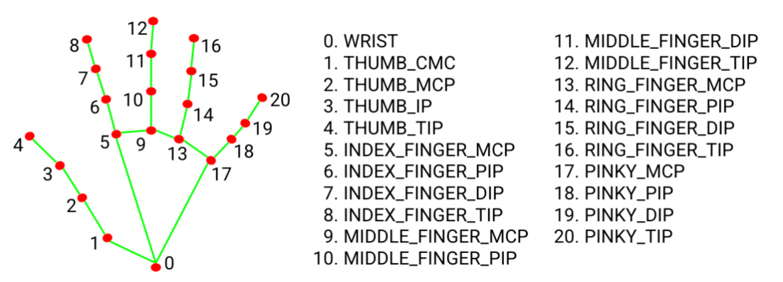
Hand Landmarks
Fig-Hand landmarks points used by MediaPipe
MediaPipe's Hand Tracking module provides a set of 21 hand landmarks or key points that represent specific locations on the human hand. These landmarks are identified by integers from 0 to 20, and each landmark has three-dimensional coordinates (x, y, z) that define its position in space

Slide 12
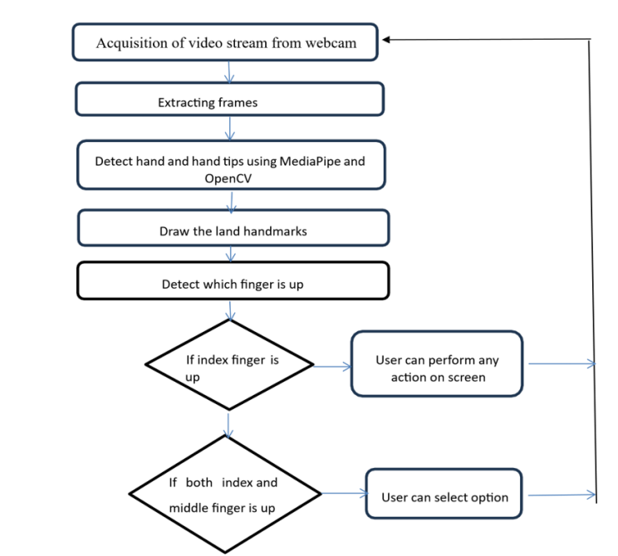
Proposed Method Illustration

Slide 13
Proposed Method Illustration
By using MediaPipe , we will track the movement of our index finger. If we are using index and middle finger then we are in selection mode, we can select any color by simply hovering over the specific color. After selection is done we will simply use the index finger to draw.
The draw mechanism works by drawing individual points at a very small interval of time that those points appear to be a line. While selecting and drawing modes we will store the location of our hand pointer with the color we are using.
Using numpy we will make a plain white canvas of (1280, 720) pixels on which we will draw, the output that we get on white canvas we will superimpose it on the original frame video window.

Slide 14
Experiment Environment
Software requirements
Visual Studio
Media Pipe
Numpy
OpenCv
Hardware requirements
Webcam
Monitor (Screen)

Slide 15
Project status
S.No | Functionality | Status (Completed /in-progress/Not started)
1. | Requirement Gathering | Completed
2. | Analysis and Design | Completed
3. | Construction of the Application | In-progress
4. | Testing | Not Started

Slide 16
References
[1] B Anand ,T.Vinod, ,M Srinivas Rao, Interaction through Computer Vision Air Canvas.2022 IEEE International Conference on Advancements in Smart, Secure and Intelligent Computing (ASSIC) .
[2]Soham Pardeshi, Madhuvanti Apar , Chaitanya Khot , Atharv Deshmukh, Air Doodle :“ A Realtime Virtual Drawing Tool”, International Journal for Research in Applied Science & Engineering Technology (IJRASET) Volume 10 Issue IV Apr 2022.
[3] Melvin Cabatuan , Isaiah Jassen Tupal . Vision-Based Hand Tracking System Development for Non-Face-to-Face Interaction. 2021 IEEE 13th International Conference on Humanoid, Nanotechnology, Information Technology, Communication and Control, Environment, and Management (HNICEM).
[4] Shaurya Gulati, Ashish Kumar Rastogi, Raghav Pradhan, Chetan Gupta, Mayank Virmani, Rahul Jana, Paint / Writing Application through WebCam using MediaPipe and OpenCV, 2022 2nd International Conference on Innovative Practices in Technology and Management (ICIPTM).
[5] Vladimir I. Pavlovic, Rajeev Sharma, Thomas S. Huang, Visual Interpretation oHand Gestures for Human-Computer Interaction: A Review, IEEE Transactions on pattern analysis and machine intelligence, VOL. 19, NO. 7, JULY 1997.
[6] Gangadhara Rao Kommu, An Efficient Tool For Online Teaching Using OpenCV, International Journal of Creative Research Thoughts(IJCRT) Volume 9, Issue 6 June 2021.

Slide 17
Thank you

